Slide 1
Course Expectation
Learn and use the fundamentals of Python programming
Functional programming
Object-oriented programming
Learn Python and SQL (via sqlite3)

Slide 2
whoami
JOHN_OLIVER_AMURAO =
{
“job”: “[“IT Trainer”, “Technology Consultant”],
“experience”: 6,
“platforms”: [“JavaScript”, “Java”, “C#”, “Visual Basic”, “PHP”, “Python”,”Low/No Code”],
“hobbies”: [“programming”,”book collecting”,”retro gaming”],
“Socials”: [“linkedin.com/in/joliveramu”,”github.com/joliveramu”]
}

Slide 3
Course Outline
Introduction to Python and Fundamentals
What is Python?
History
How to install
How to run basic Python program
Fundamentals
Syntax
Variables
Data types
Input/Output
Operators
Control flow (conditional and looping)

Slide 4
What is Python?
Python is an interpreted, object-oriented, high-level programming language.
Python is an easy to learn, powerful programming language.
Python’s elegant syntax and dynamic typing, together with its interpreted nature, make it an ideal language for scripting and rapid application development in many areas on most platforms.

Slide 5
History of Python
It was created by Guido van Rossum and released in 1991.
The name of the Python programming language comes from an old BBC television comedy sketch series called Monty Python’s Flying Circus.

Slide 6
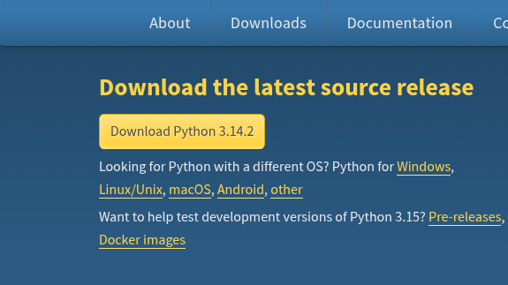
How to Install?
Download the compiler from here -> https://www.python.org

Slide 7

How to run basic python program?
To run a python program, you can either do any of the following approach(es):
In your terminal, type python3 or python
If you have a python program, in your terminal type python3/python <filename.py>

Slide 8
Fundamentals - Syntax
name="John"
print("Hello world!")
print(1+2)
print(3-1)
print(6*1)
print(2%1)
age=25
print(age)

Slide 9
Fundamentals - Variables
are containers for storing data values. A variable is created the moment you first assign a value.
to it.
variable_name = 4 # variable_name is of type int
variable_name = "Python" # variable_name is now of type str
print(variable_name)

Slide 10
Fundamentals - Data Types
Type of data stored in a variable
● String Ordered sequences of characters enclosed in single or double quotes.
(“Hello World”, “U$niverse*”) str()
● Integer Whole numbers, positive or negative, without a fractional component. (1,5,-3,-2) int()
● Float Numbers with decimal points or in exponential form. (1.5,2.6, 1.67, 500.45) float()
● Boolean Logical values, either True or False.(True, False) bool()

Slide 11
Fundamentals - Data Types
● List are ordered, mutable collections of items, which can hold elements of different data types.([1,2,3,4,5]) list()
● Tuple often used to store fixed collections of data where immutability is important(1,5,-3,-2) tuple()
● Dictionary are highly versatile and allow you to efficiently organize and retrieve data using meaningful keys rather than relying on numerical indexes.( {'Name': 'Zara', 'Age': 7, 'Class': 'First'}) dict()
● Sets Unordered collections of unique elements. ({"apple", "banana", "cherry"}) sets()

Slide 12
Fundamentals - Data Types
TYPE CASTING
The process of converting the value of one data type (integer, string, float,
etc.) to another data type is called type conversion. Python has two types
of type conversion.
Implicit Type Conversion
Python automatically converts one data type to another data type
Explicit Type Conversion
Users convert the data type of an object to required data type int(), float(), str()

Slide 13
Fundamentals - Input/Output
INPUT
● When input() function executes program flow will be stopped until the user has given an input.
● The text or message display on the output screen to ask a user to
enter input value is optional i.e. the prompt, will be printed on the
screen is optional.
name = input("Enter name: ")
age = int(input("Enter age: "))

Slide 14
Fundamentals - Input/Output
OUTPUT
Print objects to the text stream file, separated by sep and followed by end. sep, end, file, and flush, if present, must be given as keyword arguments.
All non-keyword arguments are converted to strings like str() does and written to the stream, separated by sep and followed by end.
print("Hello, world!")
print("1","2",sep=",")
print("Hello, world!","Hola mundo!",end="*")

Slide 15
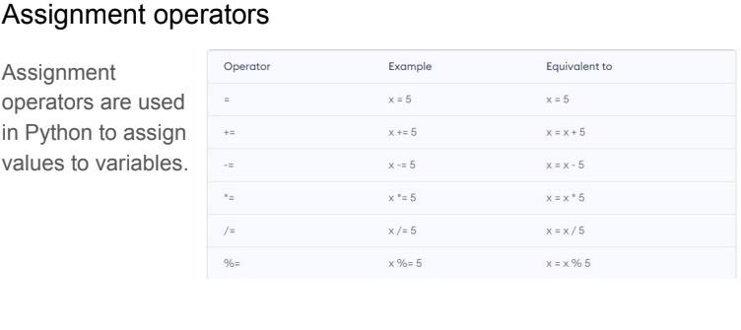
Fundamentals - Operators

Slide 16
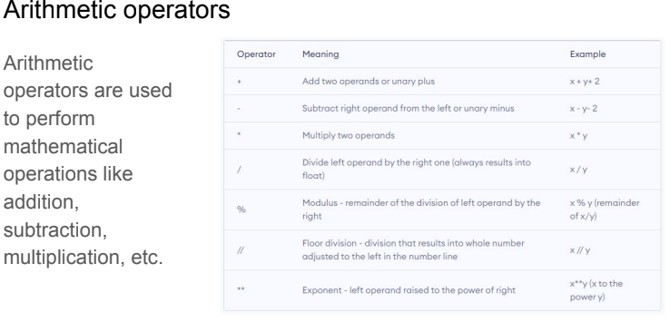
Fundamentals - Operators

Slide 17
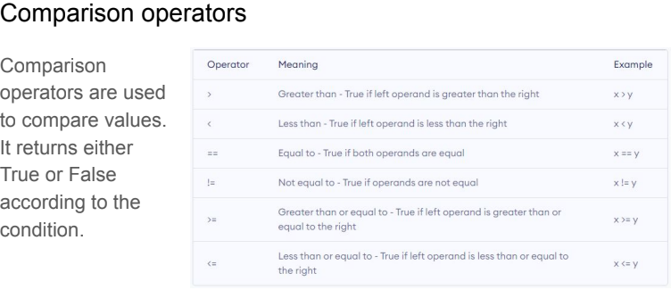
Fundamentals - Operators

Slide 18
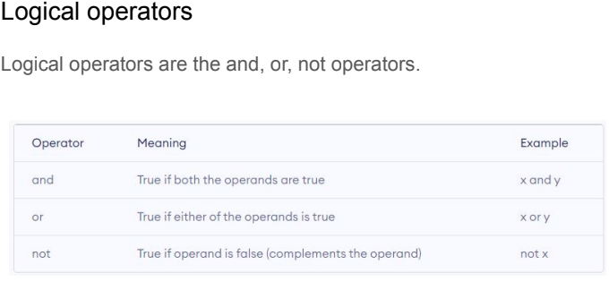
Fundamentals - Operators

Slide 19
Control Flow/Structures
CONTROL STRUCTURES
● Statements in a program are executed sequentially, from the first statement to the last statement.
● Control structures provide a means for some statements to be skipped or by-passed during execution, depending on the result of a condition(s).

Slide 20
Control Flow/Structures - Conditionals
Selection (or Decision Control) Structure
Provides a choice between two alternatives
3 components of the structure:
A condition to be tested
  The statement to be performed if the condition is satisfied (process A)
  The statement to be performed if the condition is not satisfied (process B)

Slide 21
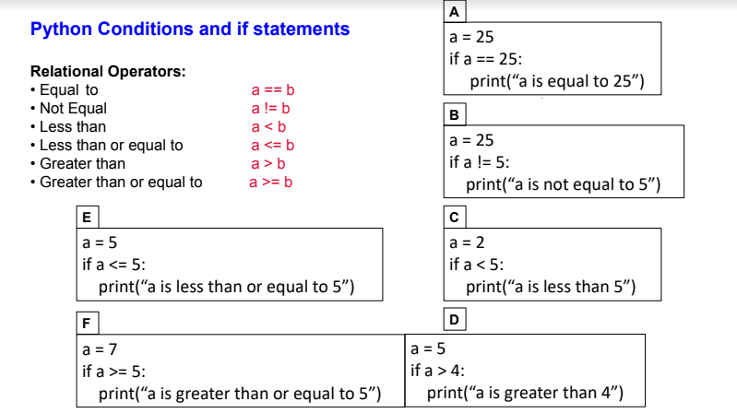
Control Flow/Structures - Conditionals

Slide 22
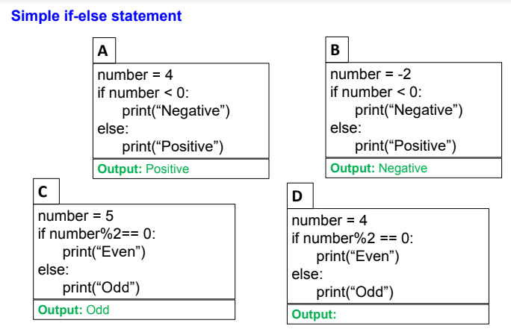
Control Flow/Structures - Conditionals

Slide 23
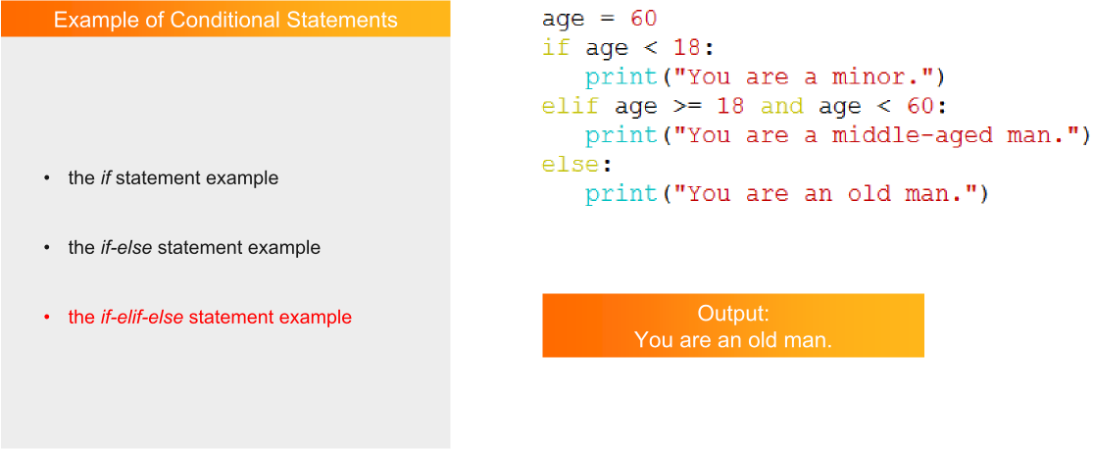
Control Flow/Structures - Conditionals

Slide 24
Control Flow/Structures - Conditionals
BUILT-IN METHODS
● isupper() - Returns True if all characters in the string are upper case
● islower() - Returns True if all characters in the string are lower case
● isdigit() - Returns True if all characters in the string are digits
● isalpha() - Returns True if all characters in the string are in the alphabet

Slide 25
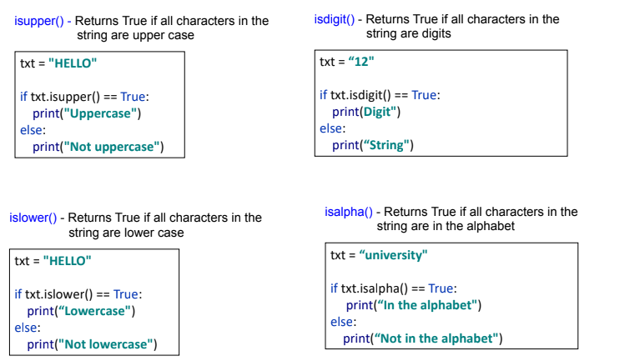
Control Flow/Structures - Conditionals

Slide 26
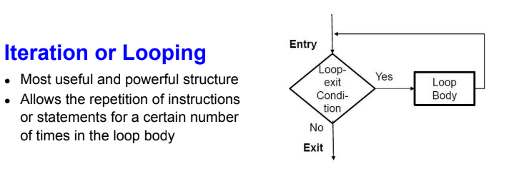
Control Flow/Structures - Looping

Slide 27
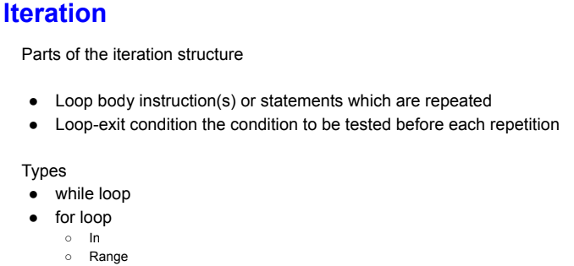
Control Flow/Structures - Looping

Slide 28
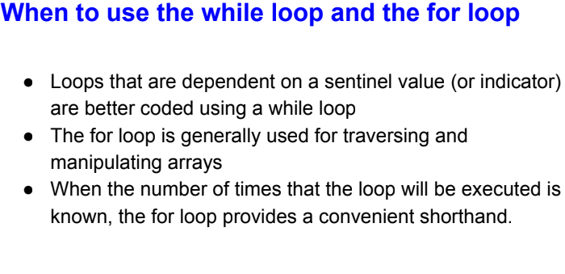
Control Flow/Structures - Looping

Slide 29
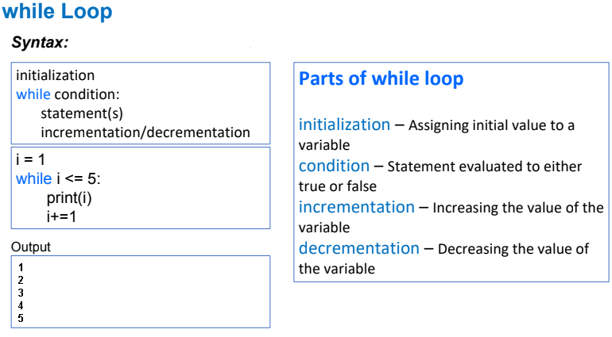
Control Flow/Structures - Looping

Slide 30
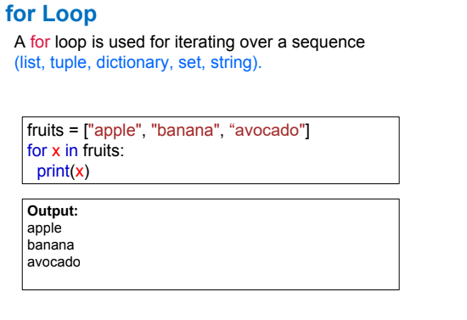
Control Flow/Structures - Looping

Slide 31
Control Flow/Structures - Looping
The in keyword serves two primary purposes: it acts as a membership operator to check if a value exists within a collection, and it acts as an iterator separator within for loops.
When used in expressions (commonly inside if statements), in checks if a specific element is present inside an iterable sequence (like a string, list, tuple, set, or dictionary). It evaluates to either True or False
When used in a loop, in separates the loop variable from the iterable collection you want to step through

Slide 32
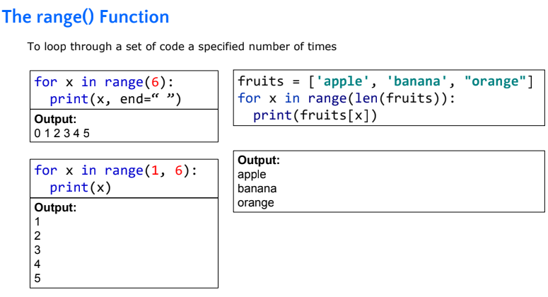
Control Flow/Structures - Looping

Slide 33
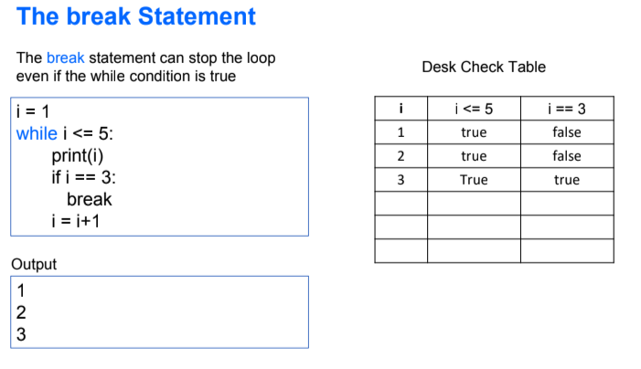
Control Flow/Structures - Looping

Slide 34
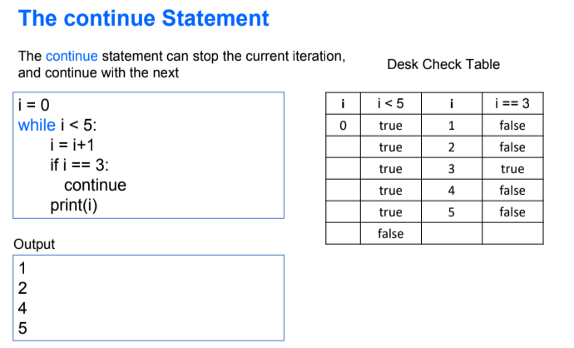
Control Flow/Structures - Looping

Slide 35
References
https://docs.python.org/3/library/stdtypes.html - Built-in types
https://www.datacamp.com/tutorial/python-data-type-conversion - Python Data Type Conversion: A Guide With Examples
https://carpentry.library.ucsb.edu/2020-08-19-Summer-Python/03-control-structures/index.html - Python control structures

